Slide 1

UML diagrams for requirements phase
CSCI 213

Slide 2
Topics
UML diagrams
Use-case
Activity diagram
Sequence diagram
Class diagram
Communication diagram

Slide 3
uml
Unified Modeling Language (UML) is a standardized visual modeling language used in the field of software engineering to provide a general-purpose, developmental, and intuitive way to visualize the design of a system. UML helps in specifying, visualizing, constructing, and documenting the artifacts of software systems.
We use UML diagrams to portray the behavior and structure of a system.
UML helps software engineers, businessmen, and system architects with modeling, design, and analysis.
The Object Management Group (OMG) adopted Unified Modelling Language as a standard in 1997. It’s been managed by OMG ever since.
The International Organization for Standardization (ISO) published UML as an approved standard in 2005. UML has been revised over the years and is reviewed periodically.

Slide 4
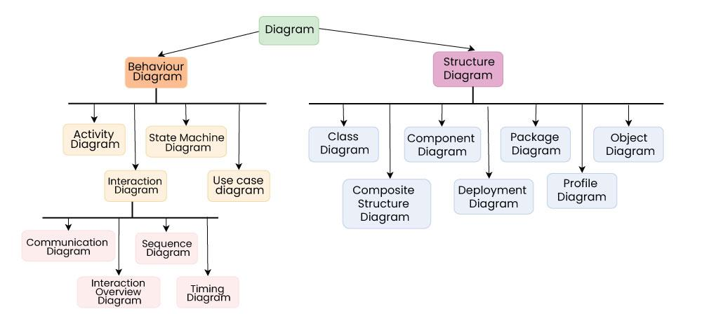
Uml
https://www.geeksforgeeks.org/unified-modeling-language-uml-introduction/

Slide 5
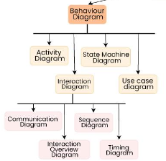
Behavioral UML Diagrams

Slide 6

Use Case Diagrams
Use Case Diagrams are used to depict the functionality of a system or a part of a system.
A use case is basically a diagram representing different scenarios where the system can be used.
A use case diagram gives us a high-level view of what the system or a part of the system does without going into implementation details.
https://www.geeksforgeeks.org/use-case-diagram/

Slide 7
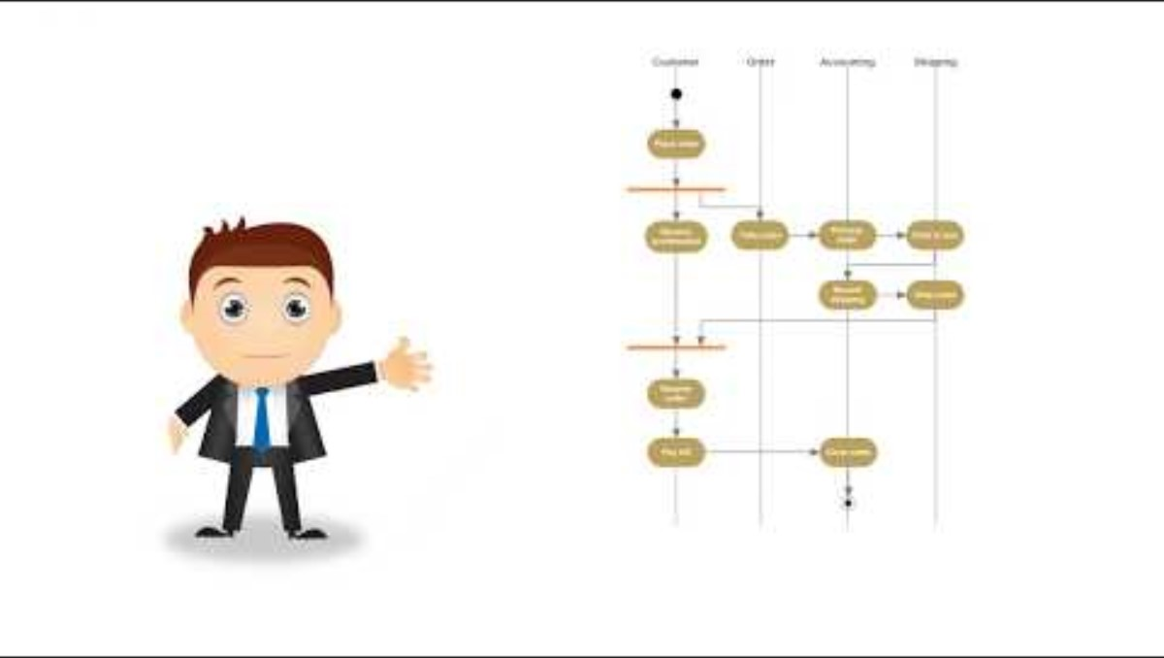
Activity Diagrams
We use Activity Diagrams to illustrate the flow of control in a system or sub-system.
We can also use an activity diagram to refer to the steps involved in the execution of a use case.
An activity diagram focuses on the condition of flow and the sequence in which it happens.
Activity Diagrams | Unified Modeling Language (UML) - GeeksforGeeks
https://www.youtube.com/watch?v=Wf_xlagfHmg

Slide 8
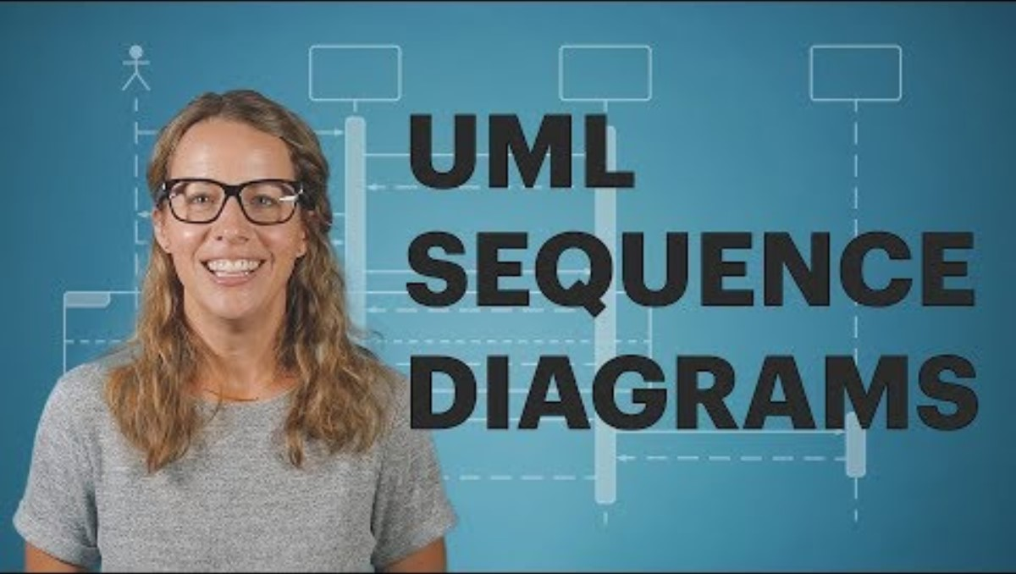
Sequence Diagrams
A sequence diagram simply depicts the interaction between the objects in a sequential order i.e. the order in which these interactions occur.
We can also use the terms event diagrams or event scenarios to refer to a sequence diagram.
Sequence diagrams describe how and in what order the objects in a system function.
These diagrams are widely used by businessmen and software developers to document and understand requirements for new and existing systems.
https://www.geeksforgeeks.org/unified-modeling-language-uml-sequence-diagrams/

Slide 9
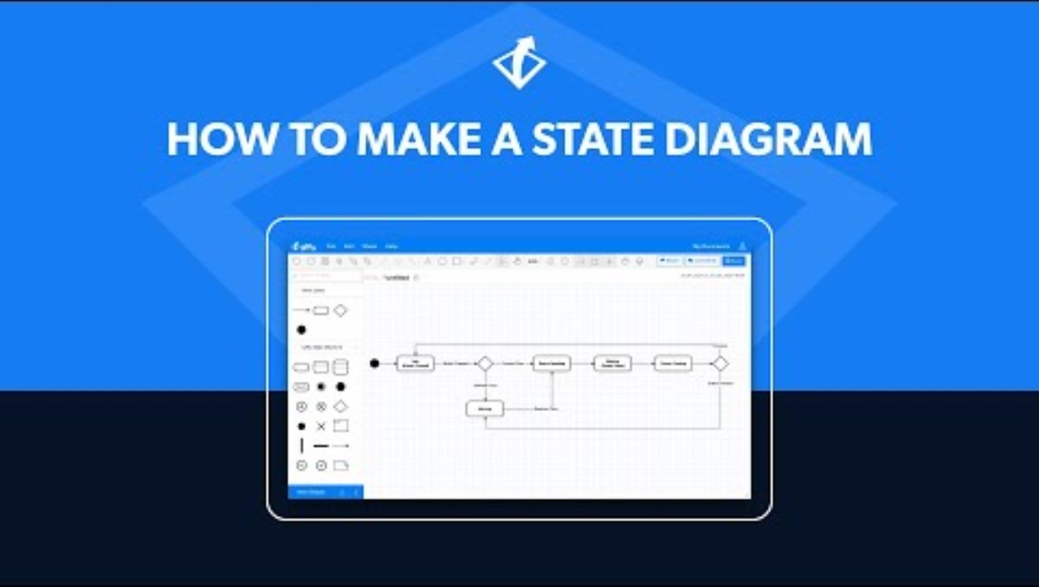
State Machine Diagrams
A state diagram is used to represent the condition of the system or part of the system at finite instances of time.
State Machine diagrams are also referred to as State Machines Diagrams and State-Chart Diagrams.
So simply, a state machine diagram is used to model the dynamic behavior of a class in response to time and changing external stimuli.
We can say that each and every class has a state but we don’t model every class using State Machine diagrams.
https://www.geeksforgeeks.org/unified-modeling-language-uml-state-diagrams/

Slide 10
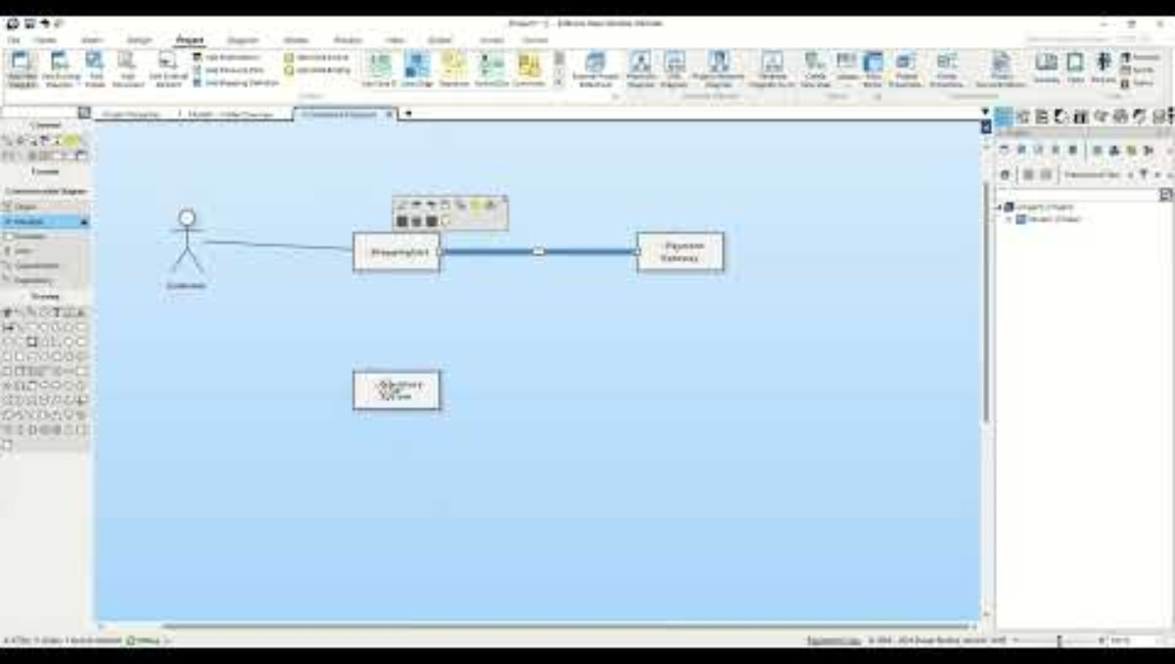
Communication Diagram
A Communication Diagram (known as Collaboration Diagram in UML 1.x) is used to show sequenced messages exchanged between objects.
A communication diagram focuses primarily on objects and their relationships.
We can represent similar information using Sequence diagrams, however, communication diagrams represent objects and links in a free form.

Slide 11
Object-Oriented Concepts Used in UML Diagrams
Class: A class defines the blue print i.e. structure and functions of an object.
Objects : Objects help us to decompose large systems and help us to modularize our system. Modularity helps to divide our system into understandable components so that we can build our system piece by piece.
Inheritance: Inheritance is a mechanism by which child classes inherit the properties of their parent classes.
Abstraction: Abstraction in UML refers to the process of emphasizing the essential aspects of a system or object while disregarding irrelevant details. By abstracting away unnecessary complexities, abstraction facilitates a clearer understanding and communication among stakeholders.
Encapsulation: Binding data together and protecting it from the outer world is referred to as encapsulation.
Polymorphism: Mechanism by which functions or entities are able to exist in different forms.
https://www.geeksforgeeks.org/unified-modeling-language-uml-introduction/?ref=shm

Slide 12
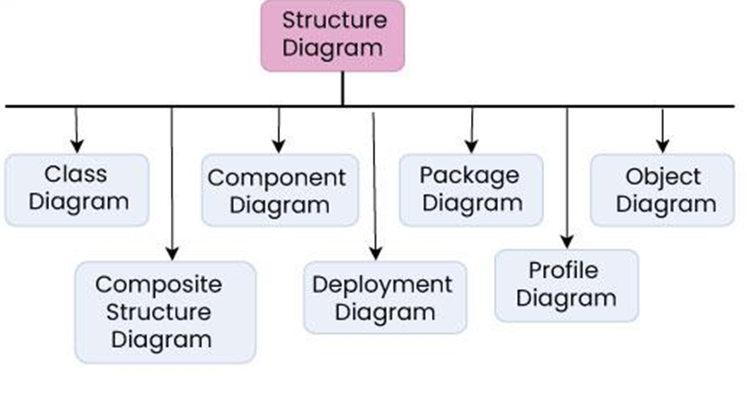
Structural UML Diagrams

Slide 13
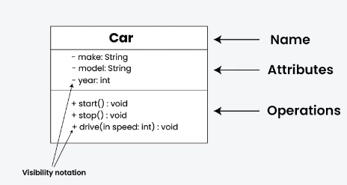
Class diagram
In object-oriented programming (OOP), a class is a blueprint or template for creating objects.
Objects are instances of classes, and each class defines a set of attributes (data members) and methods (functions or procedures) that the objects created from that class will possess.
The attributes represent the characteristics or properties of the object, while the methods define the behaviors or actions that the object can perform.
https://www.geeksforgeeks.org/unified-modeling-language-uml-class-diagrams/#what-is-a-class

Slide 14


Slide 15
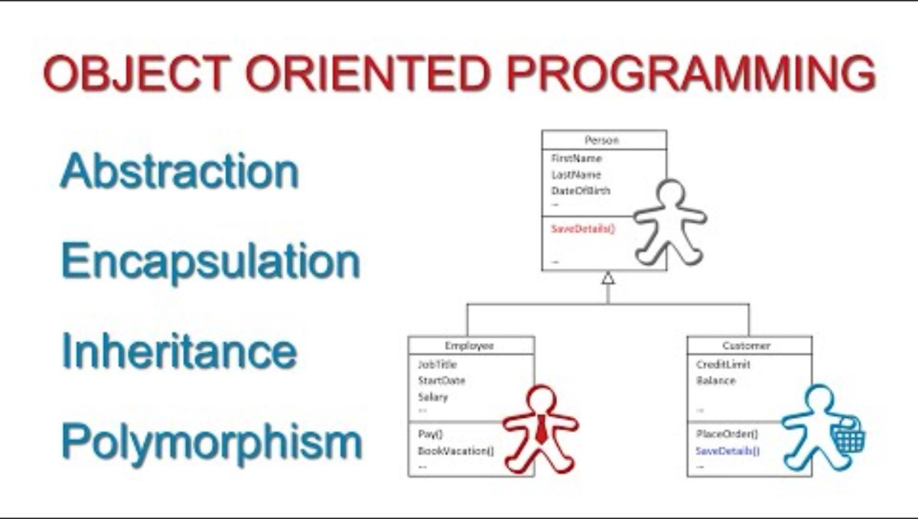

Slide 16
Software Requirement Specification (SRS) and UML
Use Case
Activity diagram
Flow diagram
State diagram
Sequence diagram
Data Flow Diagram
Use case description/scenario
Entity Relationship Diagram
+

Slide 17
Use cases and use case scenarios
Use cases and scenarios are powerful tools used in business analysis to define the functional requirements of a system or software.
A use case describes how a user interacts with a system to achieve specific goals.
Use case scenario is an instance or sequence of events that illustrates how the system behaves in response to those user interactions.

Slide 18
Elements of Use Case Description
The elements of a use case description typically include the following:
Title/Name: A concise and descriptive name for the use case.
Actors: The individuals or entities interacting with the system.
Description: A brief overview of what happens within the use case.
Preconditions: The conditions must be met before the use case can be executed.
Main Flow: The step-by-step sequence of events during normal execution.
Alternate Flows: Any deviations from the main flow, such as error handling or exception scenarios.
Postconditions: The system's state after completing the use case.
Related Use Cases: Any other use cases related to or triggered by this one.

Slide 19
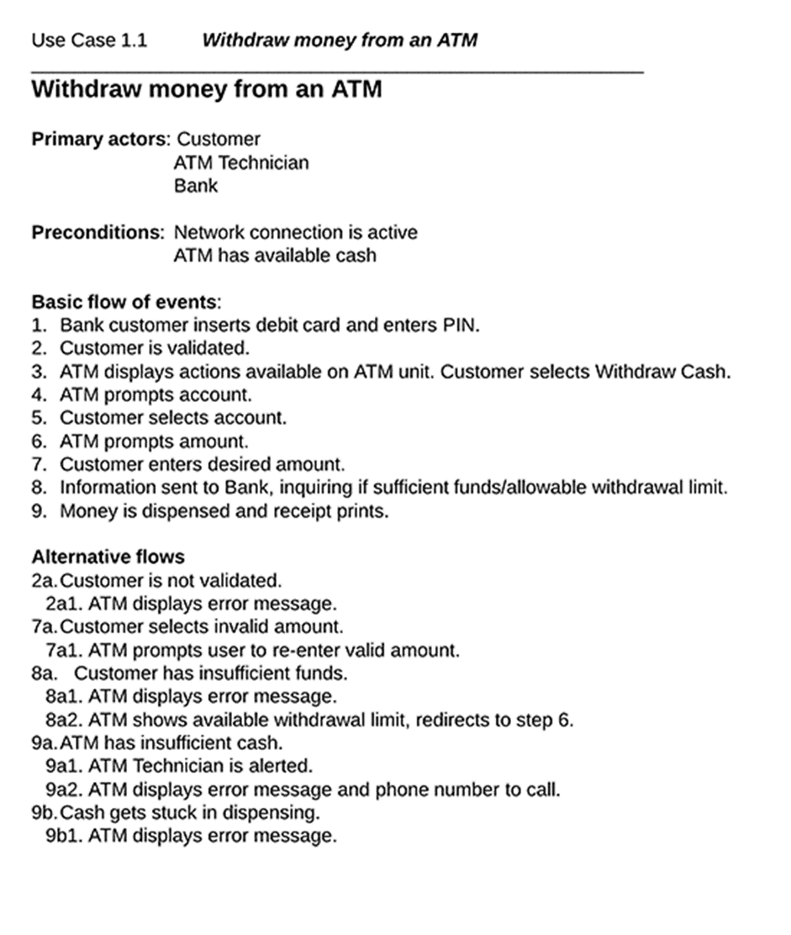

Slide 20
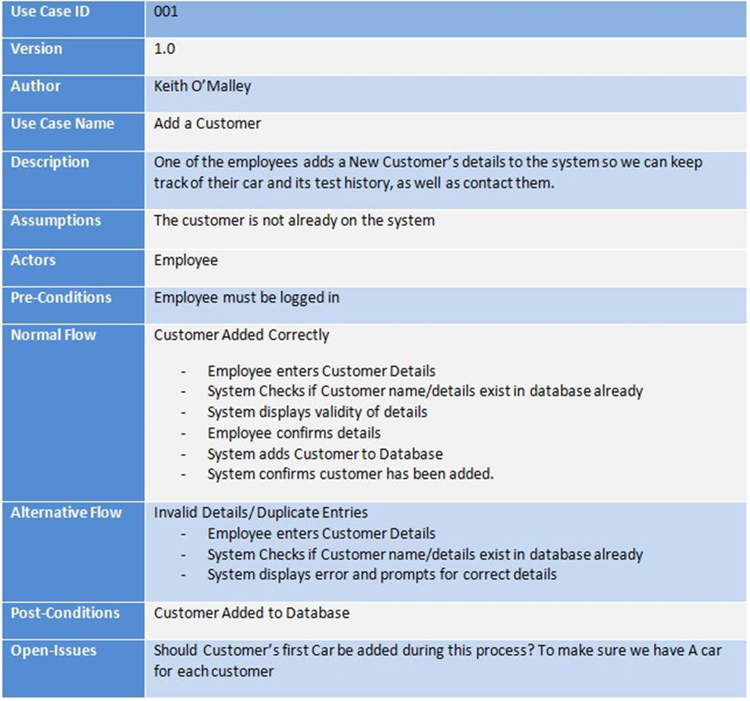

Slide 21
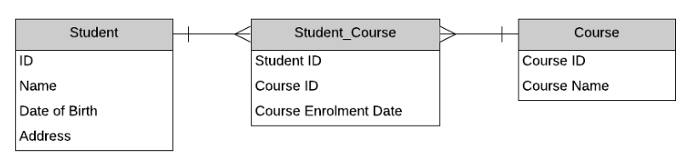
Entity Relationship Diagram (ERD)
An Entity Relationship Diagram (ERD) is a type of diagram that lets you see how different entities (e.g. people, customers, or other objects) relate to each other in an application or a database.
They are created when a new system is being designed so that the development team can understand how to structure the database.
Entity Relationship Diagrams use a specific set of symbols, such as shapes and arrows, to depict the system and database.
https://www.databasestar.com/entity-relationship-diagram/
https://www.lucidchart.com/pages/er-diagrams?usecase=erd#discoveryTop

Slide 22
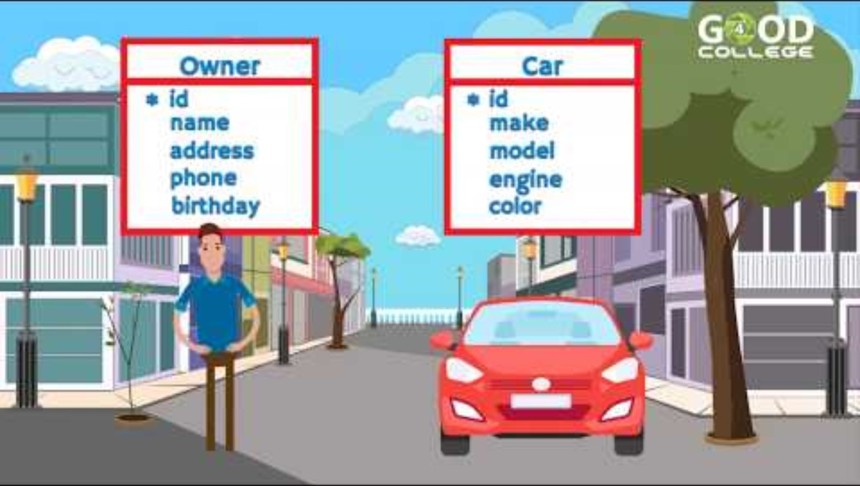

Slide 23
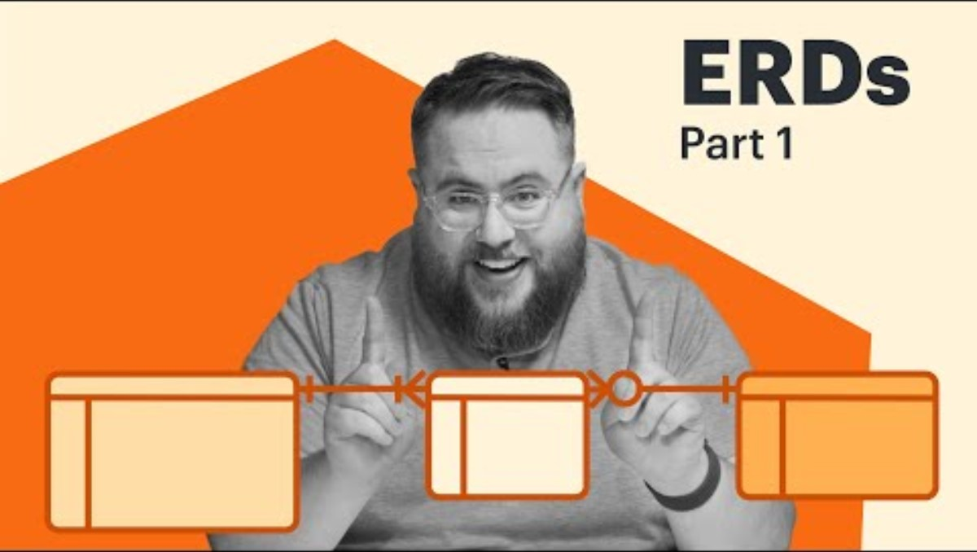

Slide 24
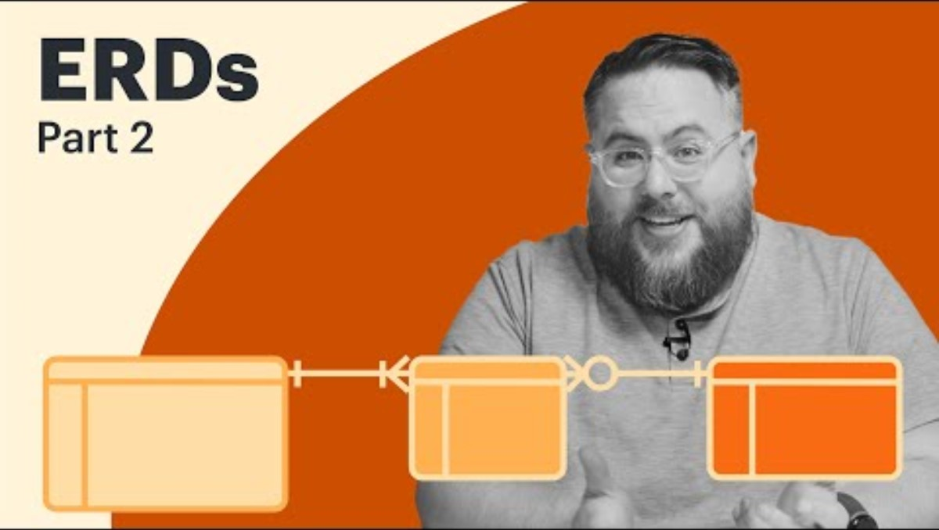

Slide 25
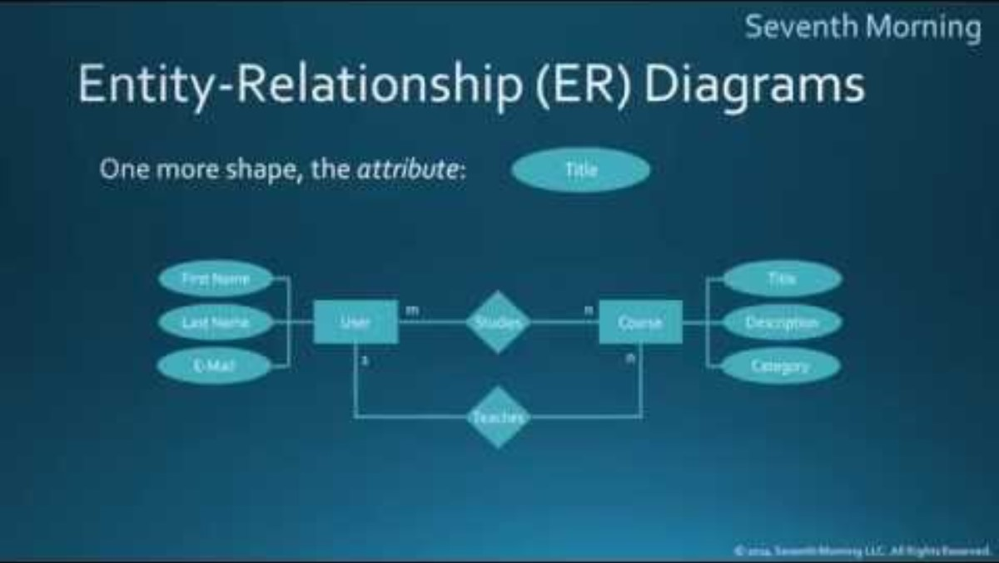

Slide 26
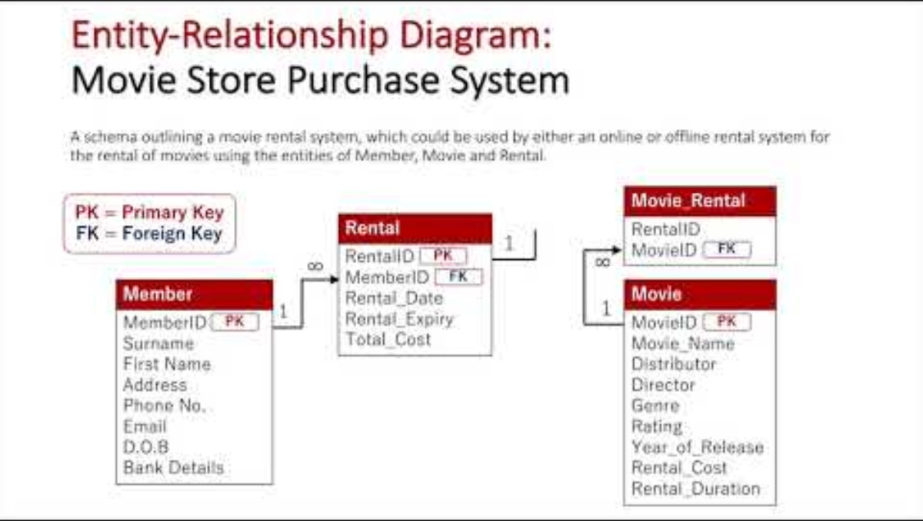

Slide 27

Thank You

